Slide 1
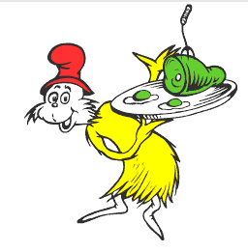
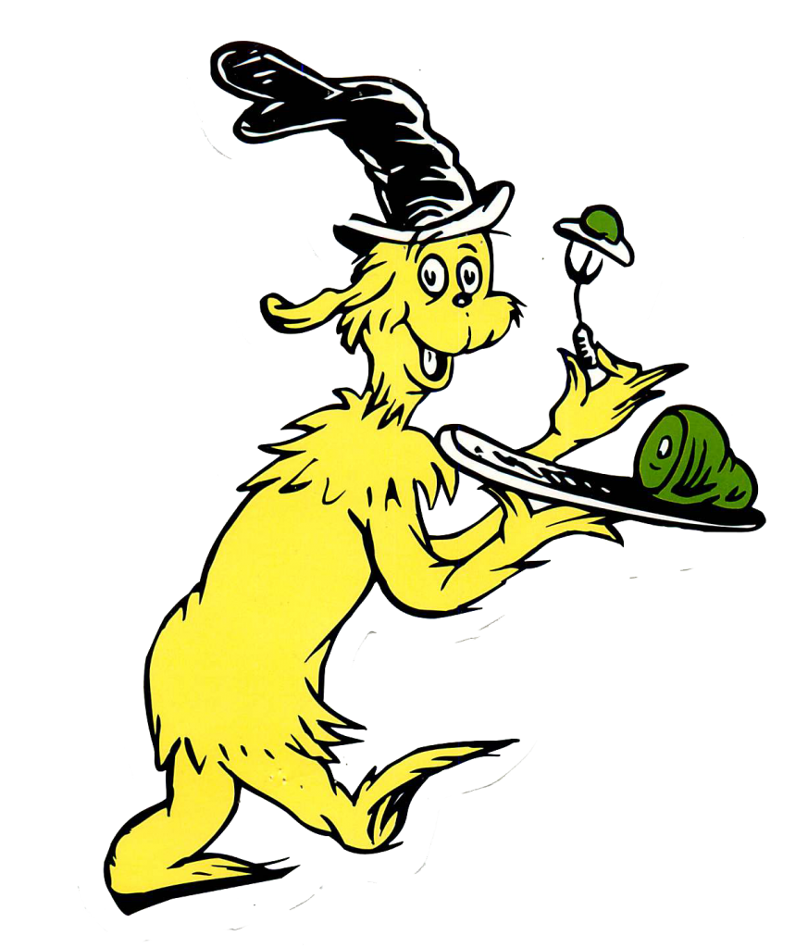
Do you like
green eggs and ham?
Students come
celebrate Dr. Seuss Day
on Monday, March 2
with a breakfast of
Green Eggs & Ham
Full menu includes green eggs, ham, fruit, and milk or juice.
Students can celebrate Dr. Seuss Day with
a Seuss inspired breakfast served especially for first grade in the school cafeteria.
The cost of the breakfast is $1.25. All students can participate even if they
do not bring money.
Send students hungry!
Say!
I like green eggs and ham!
I do! I like them, Sam-I-am!

